Slide 1

AI, Machine / Deep Learning

Slide 2
Ecosystem
“
Concept
Artificial Intelligence
a broad set of methods, algorithms and technologies that make software 'smart' in a way that may seem human-like to an outside observer.
Lynne Parker, NSF
”
Machine Learning
Univariate Linear Regression
Deep Learning
NLP
Neural Network
Named Entity Recognition

Slide 3



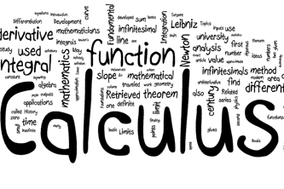
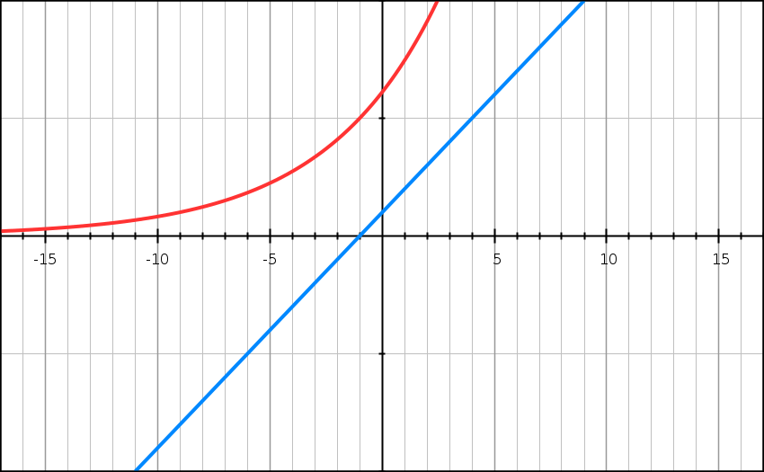
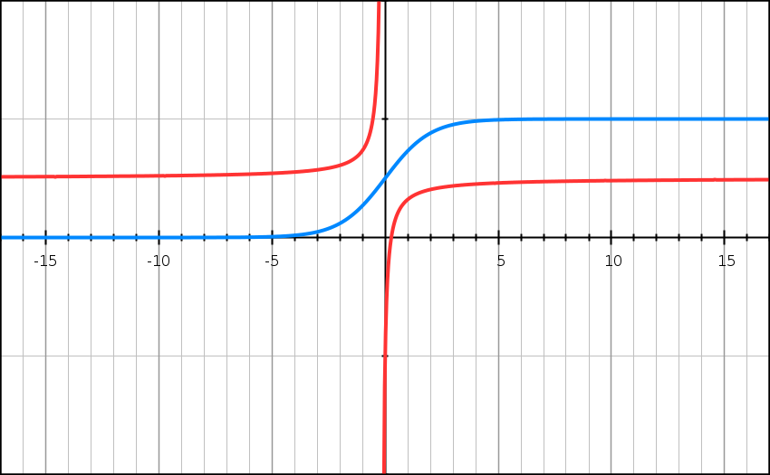
Ecosystem
Machine Learning
Data Analysis
Mathematics & Statistics
Data Graphs
Tools, Frameworks & Libraries
Notes:
Journey to this point
Data Analysis –
Tools: Excel, Access, RDBMS, Orange, R
Mathematics – Calculus, Functions, Venn Diagrams
Data graphs – Sigmoid, tanh, hyperbole, linear regression, Logistic Regression
Tools – Python, Tensorflow, Tensorboard, AWS, Azure, Jupyter Notebooks, Anaconda, Spyder

Slide 4
Terminologies are Important
Notes:
Input Data
Output / Class / Label
Training / Learning rate / Hyperparameters
Dataset
Epochs, batch size, iterations
Neurons
Neural Network
Activation networks
Multilayer Perceptron – Non linear activation networks,
Gradient Descent for backpropagation
Cross Entropy

Slide 5
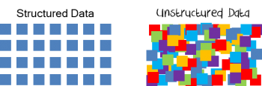
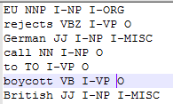
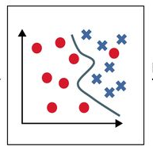


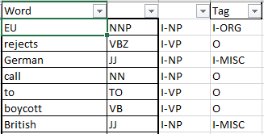
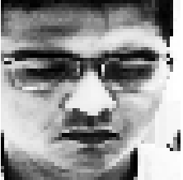
Typical ML Approach
Machine Learning Algorithms
Data processing Modules
Structured Data
Data Pre-processing
Prepared Data
Feature Extraction
Training
Best Model
Unstructured Data
f(x)
Training
Supervised
Un-Supervised
Semi-Supervised
Reinforced
Notes:
Example of data preparation like DNA, Housing, Flight delays
Data pre-processing example on NLP
Feature extraction from image and text perspective
Type of training – Supervised, Un/Semi Supervised
Function or Model Algorithm
Model type – Also talk about ADABoost

Slide 6
Data Visualization
Where to get the data from?
Type of data
Type of features
Operations intended

Slide 7
Types of Training
Supervised
Unsupervised Training
Semi-Supervised Training
Reinforcement Training

Slide 8
Tools
Feature extraction / finetuning existing models: Use Caffe
Frameworks | Caffe | Torch | Theano | Tensorflow
Language | C++, Python | Lua | Python | Python
Pre-trained Models | Yes | Yes | Yes | Inception
GPU | Yes | Yes | Yes | Yes
GPU (Parallel Models) | No | Yes | ?? | Yes
Source Code | C++ | Lua | ?? | ??
RNN | No | Average | Yes | Yes (Best)
Complex uses of pretrained models: Use Torch
Write your own layers: Use Torch
RNNs: Use Theano or TensorFlow
Huge model, need model parallelism: Use TensorFlow

Slide 9
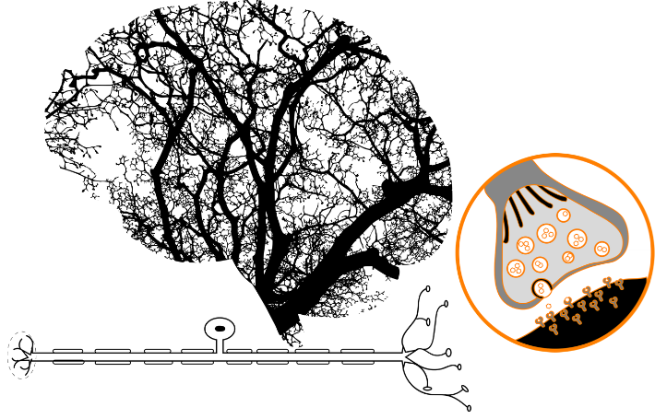
What is Neural Network ?

Slide 10
NN Use Case
?
?
?
?
Solid
Vertical
Diagonal
Horizontal

Slide 11
NN Use Case
-1.0
-.75
0.0
.5
.75
1.0
Tools, Frameworks & Libraries

Slide 12
NN Use Case using Linear Functions
Input Neurons
Output Neurons
0.5
Solid
-.2
+
S
S
0.0
+
S
S
Vertical
0.0
0.8
+
S
S
- 0.75
Diagonal
1.0
-.5
+
S
S
-1.0
0.75
Horizontal
Hidden Neurons
Notes:
Four Features –
Solid
Vertical
Diagonal
Horizontal
Weights are 1.0, -1.0 and 0.0

Slide 13
NN Use Case using Linear Functions
RELU
0.0
Input Neurons
Output Neurons
0.0
0.0
Solid
-.2
S
S
0.0
0.0
0.0
0.0
0.0
S
S
Vertical
-1.0
0.0
0.0
0.8
S
S
0.0
- 0.75
Diagonal
1.0
-.5
S
S
0.0
0.0
-1.0
0.75
-1.0
-1.0
Horizontal
Hidden Neurons
1.0
Notes:
Four Features –
Solid
Vertical
Diagonal
Horizontal
Weights are 1.0, -1.0 and 0.0
Explain Rectified Linear Unit

Slide 14

Is that so straight forward for me to learn?
Notes:
Error Function & Back propagation

Slide 15
NN Use Case
What activation function to choose?
What NN Architecture should I choose?
Activities once model is created

Slide 16

Any questions ?
Thank You!

